Slide 1

Capston Project Retail Analysis
Thanu sree chittibommala

Slide 2
Problem Statement
Leveraging a retail dataset comprising offices, employees, customers, products, product lines, orders, order details, and payments, this project aims to extract actionable insights. By delving into key areas such as office, employee, customer, product, and order analysis, the objective is to optimize business processes, elevate decision-making, and ultimately enhance overall strategies in the dynamic retail landscape. The end goal is to provide stakeholders with a robust analytical tool, fostering informed decision-making and sustained success in the competitive retail market. By using Excel , SQL and also develop a Power Bi dashboard which will offer valuable insights and recommendations for targeted marketing

Slide 3
Objective, Analysis and scope, Goal
Objective: The objective of this project is to develop a Power BI dashboard using the Retail Database to provide comprehensive insights into the retail business's performance.
Analysis and scope : The dashboard will focus on sales, product, customer, and demographic analysis, aiming to facilitate data-driven decision-making, optimize sales strategies, and enhance customer experiences.
Goal: The goal is to empower retail stakeholders with actionable insights, enabling them to identify top-selling products, customer preferences, and target demographics.

Slide 4
Insights and recommendations, Report and presentation, Dashboard
Insights and recommendations : The dashboard will offer valuable insights and recommendations for targeted marketing, inventory optimization, and personalized customer experiences.
Report and Presentation : The final deliverables will include a report and presentation showcasing the dashboard's findings and significance, serving as a powerful tool for retail stakeholders to improve business strategies and achieve success in the competitive retail market.
Dashboard: The Final Dashboard will consist of the things as per the requirement and it will help us to understand the detailed information of every aspect of the retail analysis considering all the factors.

Slide 5
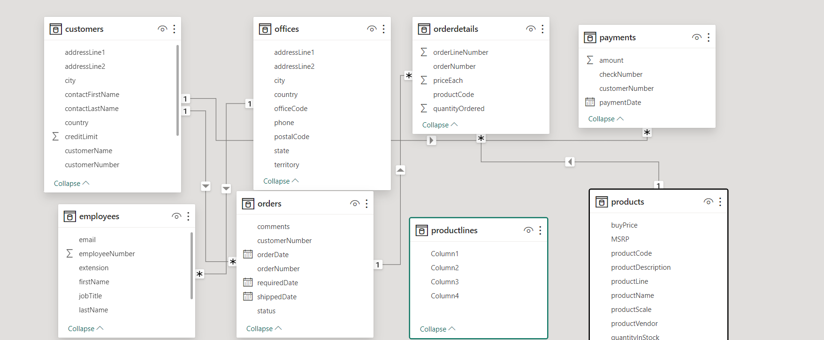
ER Diagram

Slide 6
POWER BI
Power Bi
Problem Statements

Slide 7
Retail analysis is the combination of Sales Analysis, Product Analysis, Customer Analysis, Demographic Analysis
Sales Analysis: Sales analysis is reviewing your sales data to identify trends and patterns. Sales data can help you make better decisions about your product, pricing, promotions, inventory, customer needs other aspects of your business. Sales analysis can be as simple as reviewing your sales figures regularly.
Product Analysis: Product analysis is the process of understanding user behavior in regards to your product or service. Product analytics data is used to determine what kind of user experience your product or service offers, using real customer feedback and behavioral data to inform future product updates or improvements.

Slide 8
Customer Analysis: Customer analytics are a form of data that shows what customers are doing and why they are doing it. This includes information like where customers shop, why they visit those stores, what they buy, and which factors influence their purchase decisions.
Demographic analysis : Demographic analysis is the collection and analysis of broad characteristics about groups of people and populations. Demographic data is very useful for businesses to understand how to market to consumers and plan strategically for future trends in consumer demand.

Slide 9
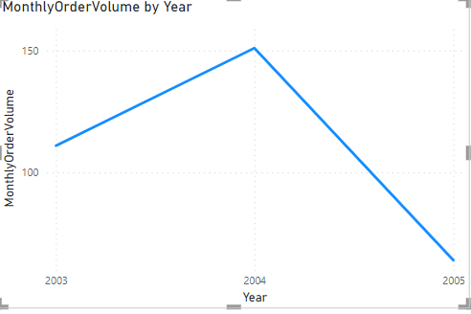
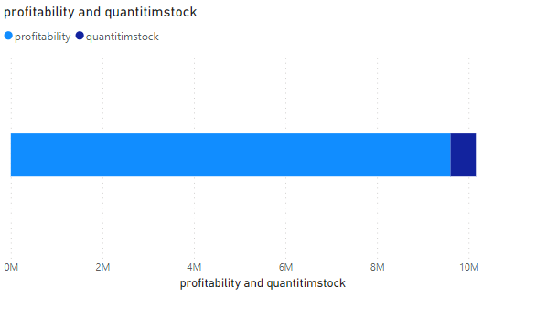
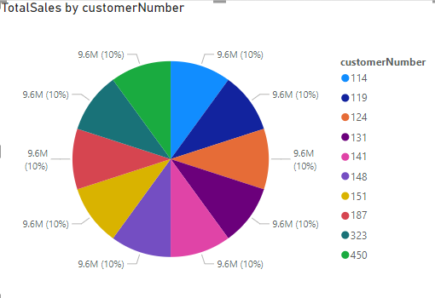
Sales Analysis

Slide 10
2Q. What is the trend in customer order volume over the past year? (Visual: Monthly order volume trend)
Explanation : on 2003 the trend was increased and 2004 it increased more but when comes to 2005 it got completely down

Slide 11
3Q. How does the sales performance of top customers compare to the rest? (Visual: Sales contribution by top customers vs. others)
Explanation : all the 10 customers they have equal contribution , having 10% of sales equally here

Slide 12
5Q. How does the profitability of different products compare based on their quantity in stock? (Visual: Profitability vs. quantity in stock)
Explanation : here in this chart , the profitability is more than the quantity stock

Slide 13
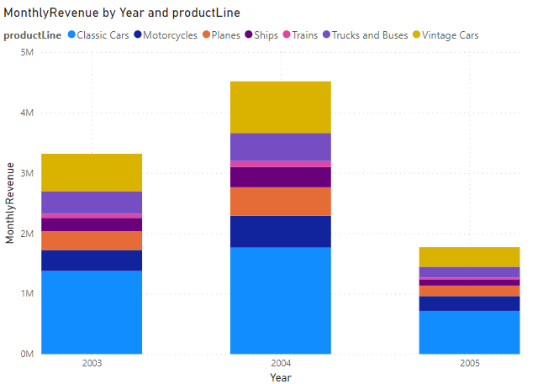
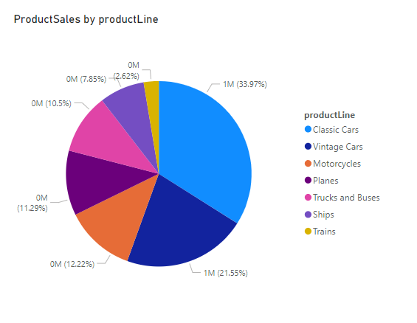
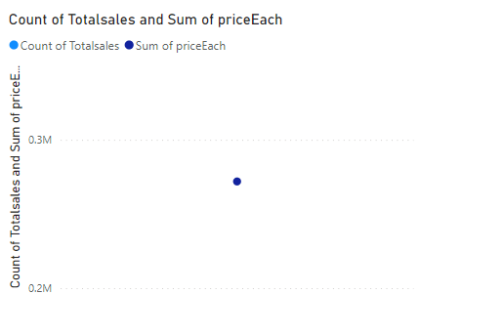
Product Analysis

Slide 14
1Q. How does monthly revenue vary across different product categories? (Visual: Monthly revenue by product category)
Explanation : on 2004 the monthly revenue is increased on various product lines

Slide 15
4Q. What is the distribution of product sales across different product lines? (Visual: Product sales by product line)
Explanation : the product line classic cars has more product sales of 33.97%

Slide 16
6Q. How does product pricing impact sales volume?
Explanation: the product pricing impact the sales volume if the pricing is less then the sales can be high

Slide 17
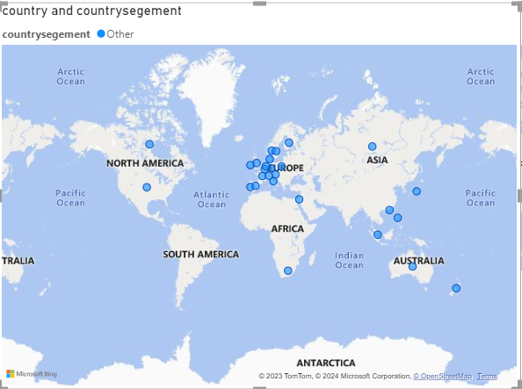
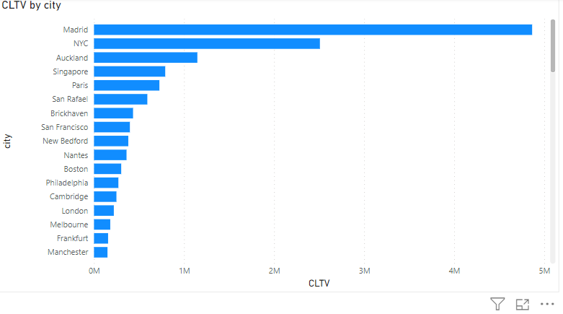
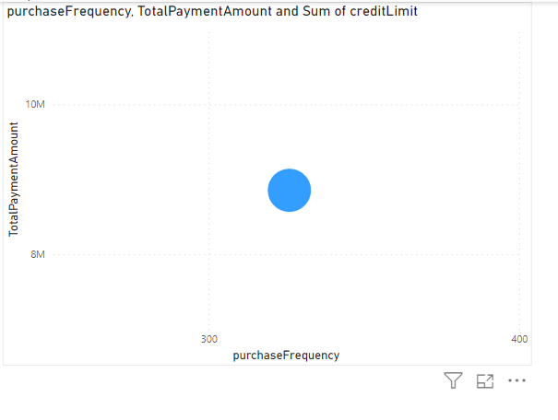
Customer Analysis

Slide 18
7Q. What is the distribution of customers across different demographic segments? (Visual: Customer segmentation by demographics)
Explanation : Here the distribution of customers can be among different countries like Asia, Australia etc..

Slide 19
8Q. How does customer lifetime value vary for different customer acquisition channels? (Visual: CLTV by acquisition channel)
Explanation: The CLTV can be definitely vary from different acquisition channels, but the channels not in data , but the CLTV has more in Madrid city

Slide 20
9Q. What is the correlation between customer age and purchase frequency?
Explanation : Here the customer age can be factor for purchase frequency , but there is no apparent linear relation between them

Slide 21
Demographic Analysis

Slide 22
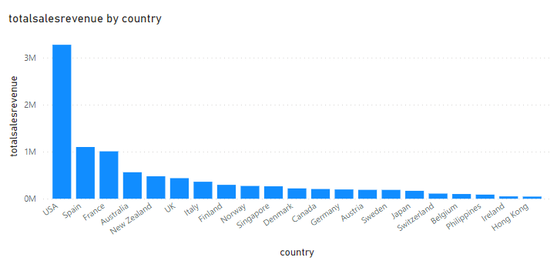
10Q. What are the top regions in terms of sales revenue? (Visual: Sales revenue by region
Explanation : USA has in the top position in terms of sales revenue and the next is spain and next is France s shown in diagram

Slide 23
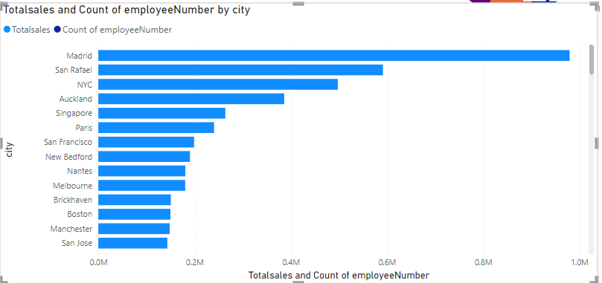
11Q. How does the performance of sales employees vary across different regions? (Visual: Employee performance by region)
Explanation : Here the madrid city has nice performance of sales there as show in chart

Slide 24
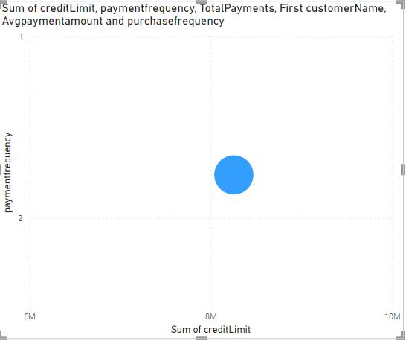
12Q. What is the correlation between customer demographics and purchase frequency?
Explanation : the correlation as shown in diagram that dt is place din middle , there is a relation coz based on demographics the purchase frequency can be there

Slide 25
EDA
EDA
Problem Statements

Slide 26
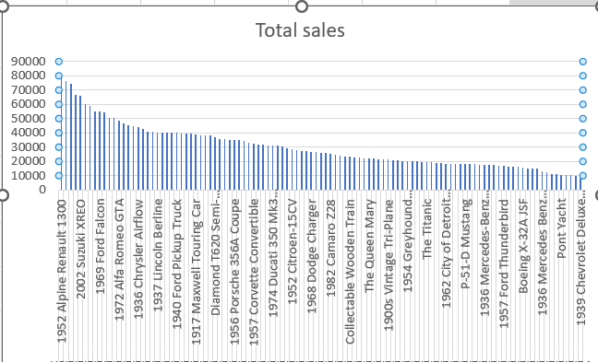
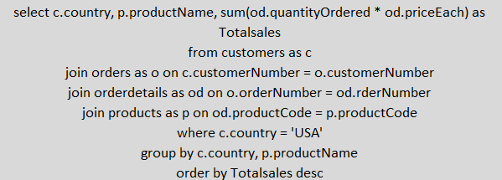
Q1. Which factors contribute to the highest sales in a particular region?
Explanation : the 1952 Alpine Renault 1300 is the product having high sales

Slide 27
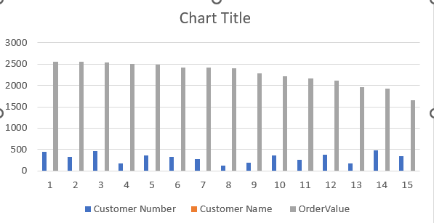
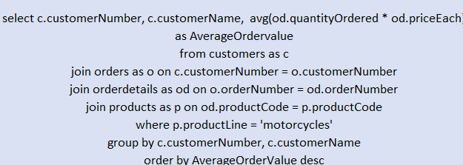
2Q.How can customer purchasing patterns be influenced to increase average order value?
Explanation : The customer purchasing patterns can be changed by order value as shown in the chart

Slide 28
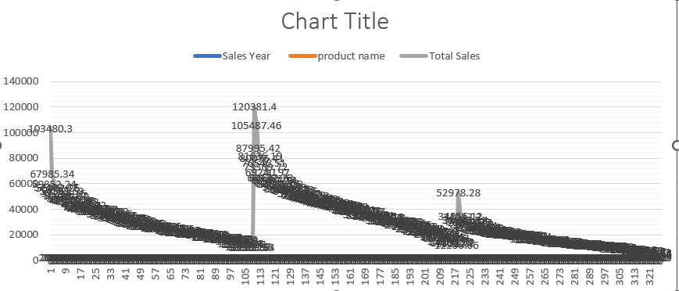
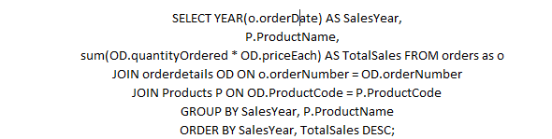
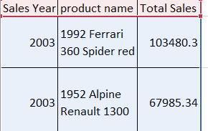
3Q. what are the key drivers of sales growth, and how can they be leveraged for future success?
Explanation: the products and related factors are imporatnat for sales growth

Slide 29
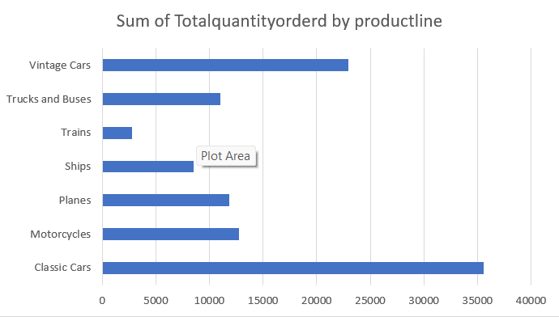
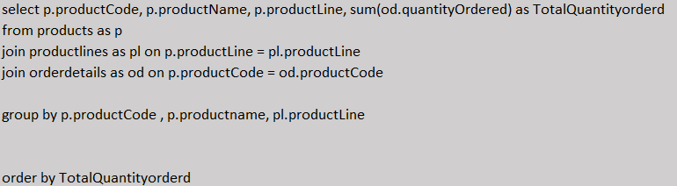
4Q.Which product features or attributes are most appealing to customers?
Explanation : the Vintage cars product line has more quantity orders , which are more appealing to customers

Slide 30
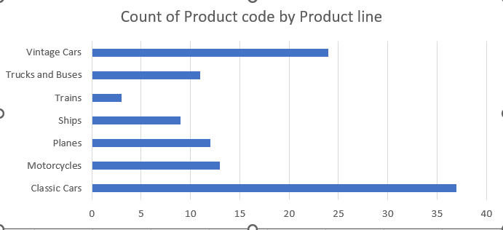
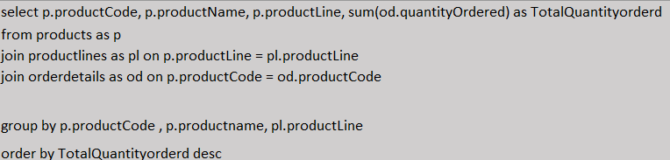
5Q.How can the product mix be optimized to cater to changing market demands
Explanation : Here the Classic cars has the more count of product code , this changes the market demands

Slide 31
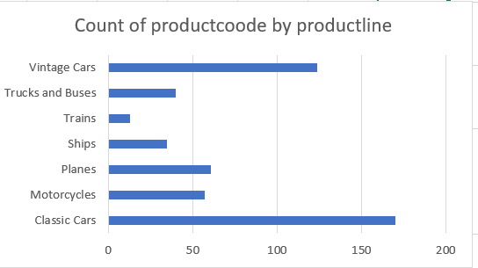
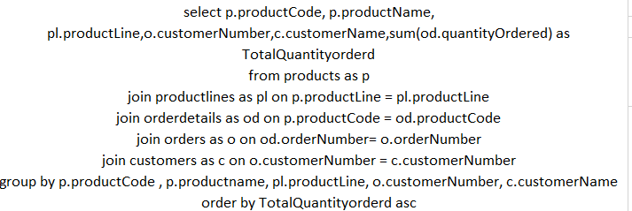
6Q. Are there any specific market segments where a particular product is underperforming, and how can it be improved?
Explanation : The Trains is performing least performance in the market

Slide 32
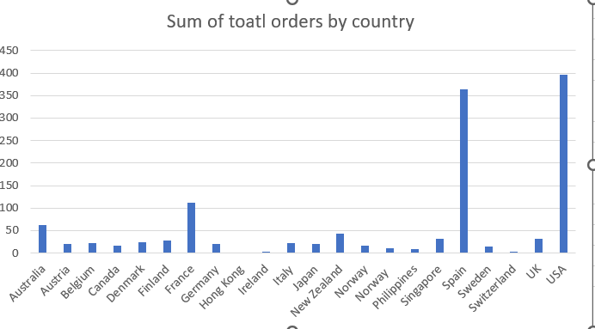
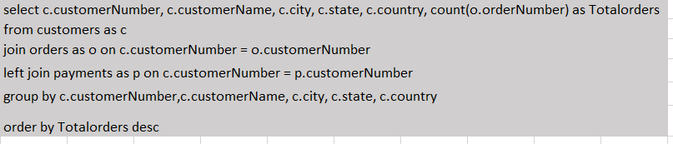
7Q.What are the main factors that influence customer loyalty and repeat purchases?
Explanation : the product lines and important factors are mainly helpful for the loyalty and repeat purchases

Slide 33
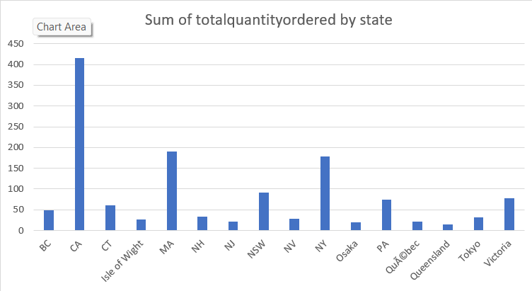
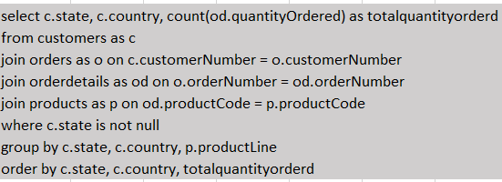
8Q. How do customer preferences differ based on geographic location, and how can marketing campaigns be customized accordingly?
Explanation : customer preferences can change, the CA state more quantity ordered

Slide 34
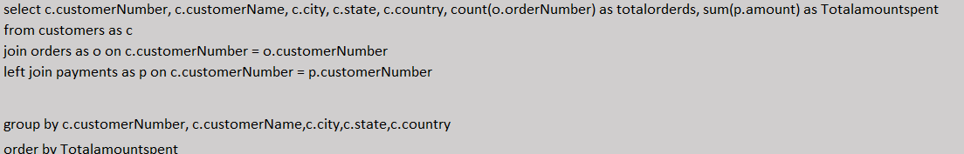
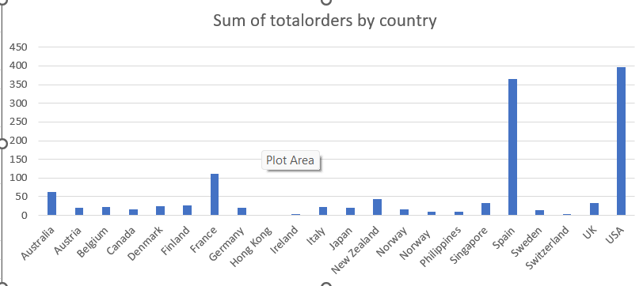
9Q. What are the characteristics of high-value customers, and how can similar customers be targeted for acquisition
Explanation : total orders are high from USA and the customer has high value

Slide 35
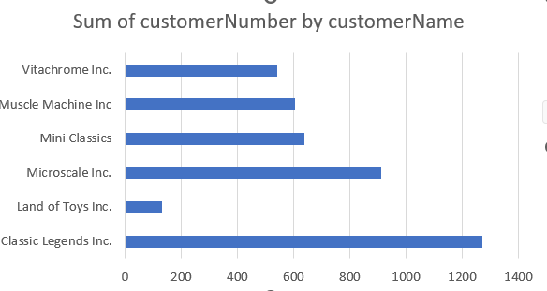
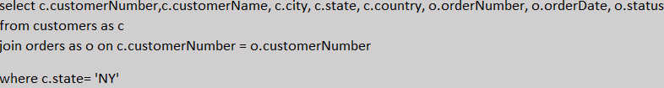
10Q. How can marketing strategies be tailored to target specific demographic segments in different regions?
Explanation : The marketing strategies can be tailored to target some segments in regions , where the classic legends has high

Slide 36
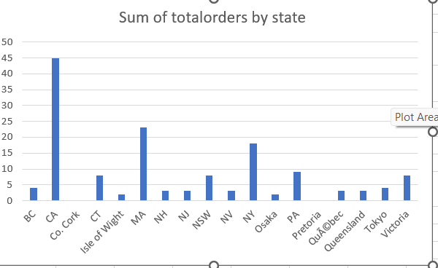
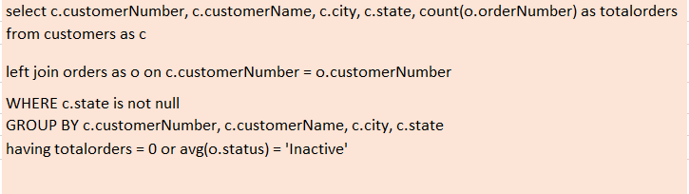
11Q.What are the potential untapped markets based on demographic indicators, and how can market penetration be increased?
Explanation : the total orders has highest in the CA state

Slide 37
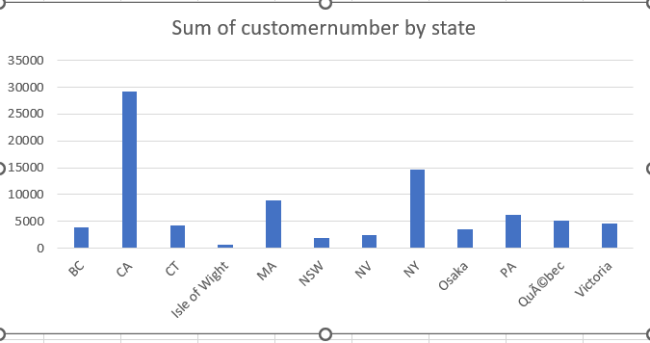
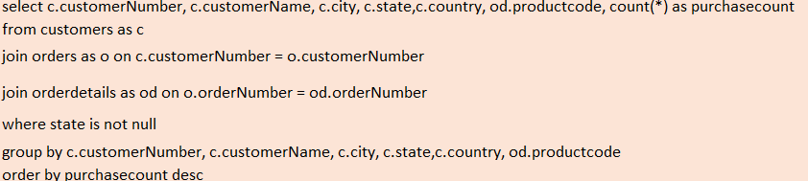
12Q. How do customer preferences and behavior differ based on demographic factors, and how can they be leveraged for personalized marketing campaigns?
Explanation : the customer preferences can be differ from regions and the CA region has highest

